Slide 1
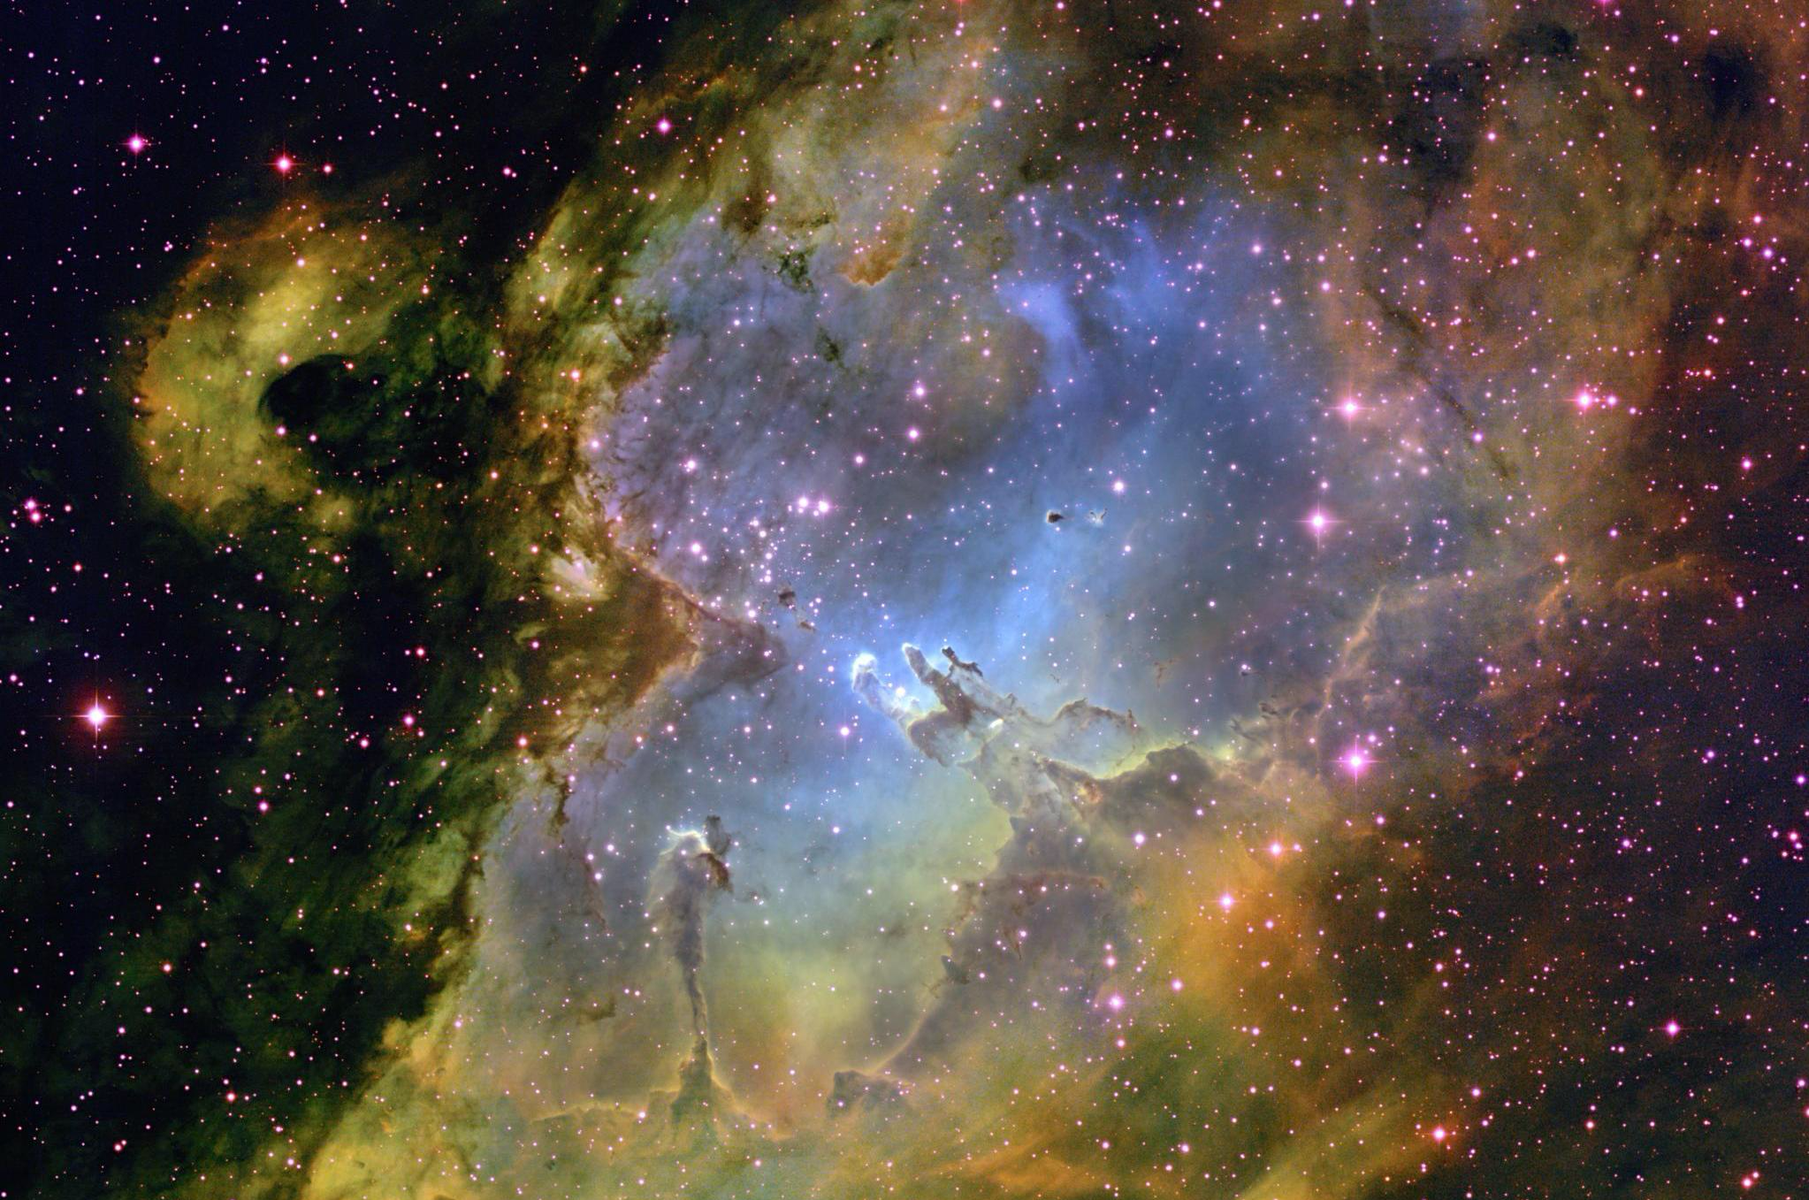
Magnetic fields And star formation in Molecular clouds

Slide 2
Contents
Molecular clouds
Magnetic fields in molecular clouds
Subregions
Filamentary structures, column density and temperature
Methods
Dust Polarization
Monte Carlo simulations
Relations between s, p and column density
Vela C molecular cloud
Subregions
Next steps

Slide 3
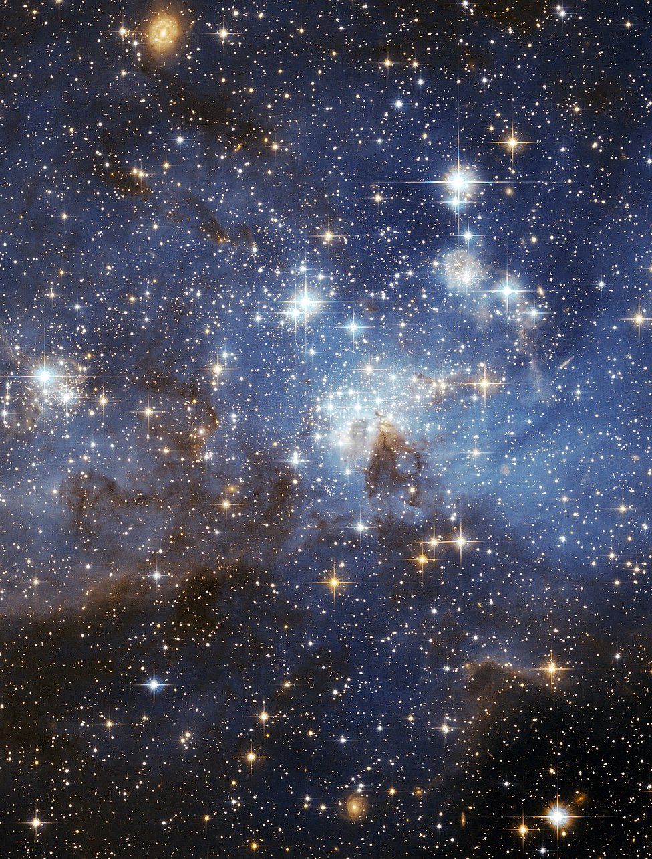
Molecular Clouds and Star formation
Star forming regions
Composed of gas and dust
> 10⁵ 𝑀⊙
Forces other than gravity within the cloud
Turbulence, stellar feedback
Thermal pressure, shock waves
Magnetic fields
Notes:
Molecular clouds
Star forming regions
- Composed of gas and dust
- Generally cooler regions of > 10⁵ 𝑀
- Star formation
- Main factors that affect star formation
Rate of star formation – 1% of observations – what provides support against collapse – thermal pressure(in pockets of gas), turbulence, shock waves, magnetic fields
- Can be broken up into sub-regions based on density, temperature and filamentary structure
- Dense regions of filaments can lead to star formation

Slide 4
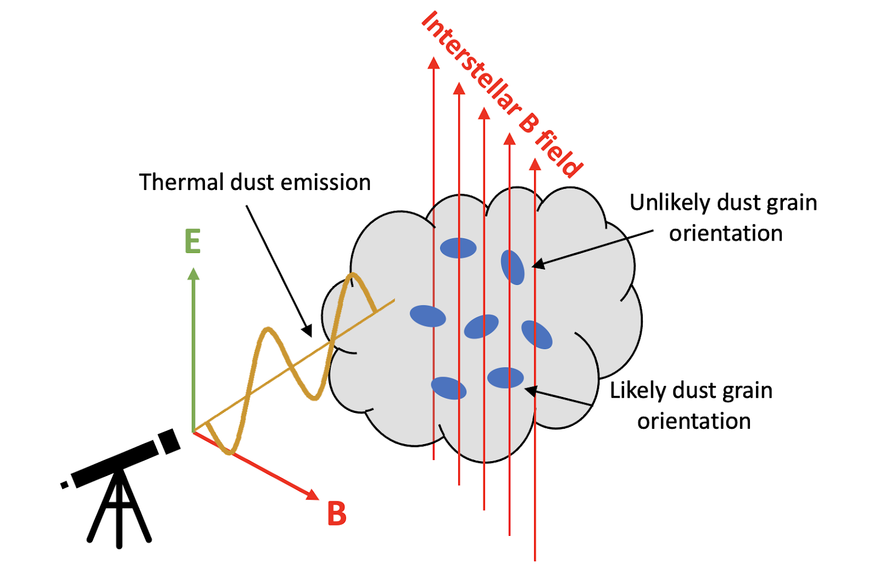
Magnetic fields in Molecular Clouds
Can inhibit collapse against gravity
Can influence formation of filamentary structures
Denser filaments align perpendicular to the magnetic field (Soler et al.(2017))
More disordered magnetic fields → weaker/more turbulence
Notes:
- Why do we look at magnetic fields
- Inhibit collapse against gravity based on direction of field
- Can influence the formation of filamentary structures, denser regions in the cloud
- Dense filaments align perpendicular to the direction of the field, less dense filaments align parallel
- Correlation between magnetic fields and turbulence
- Can reduce star forming efficiency for stronger fields where particles accrete along magnetic field lines

Slide 5
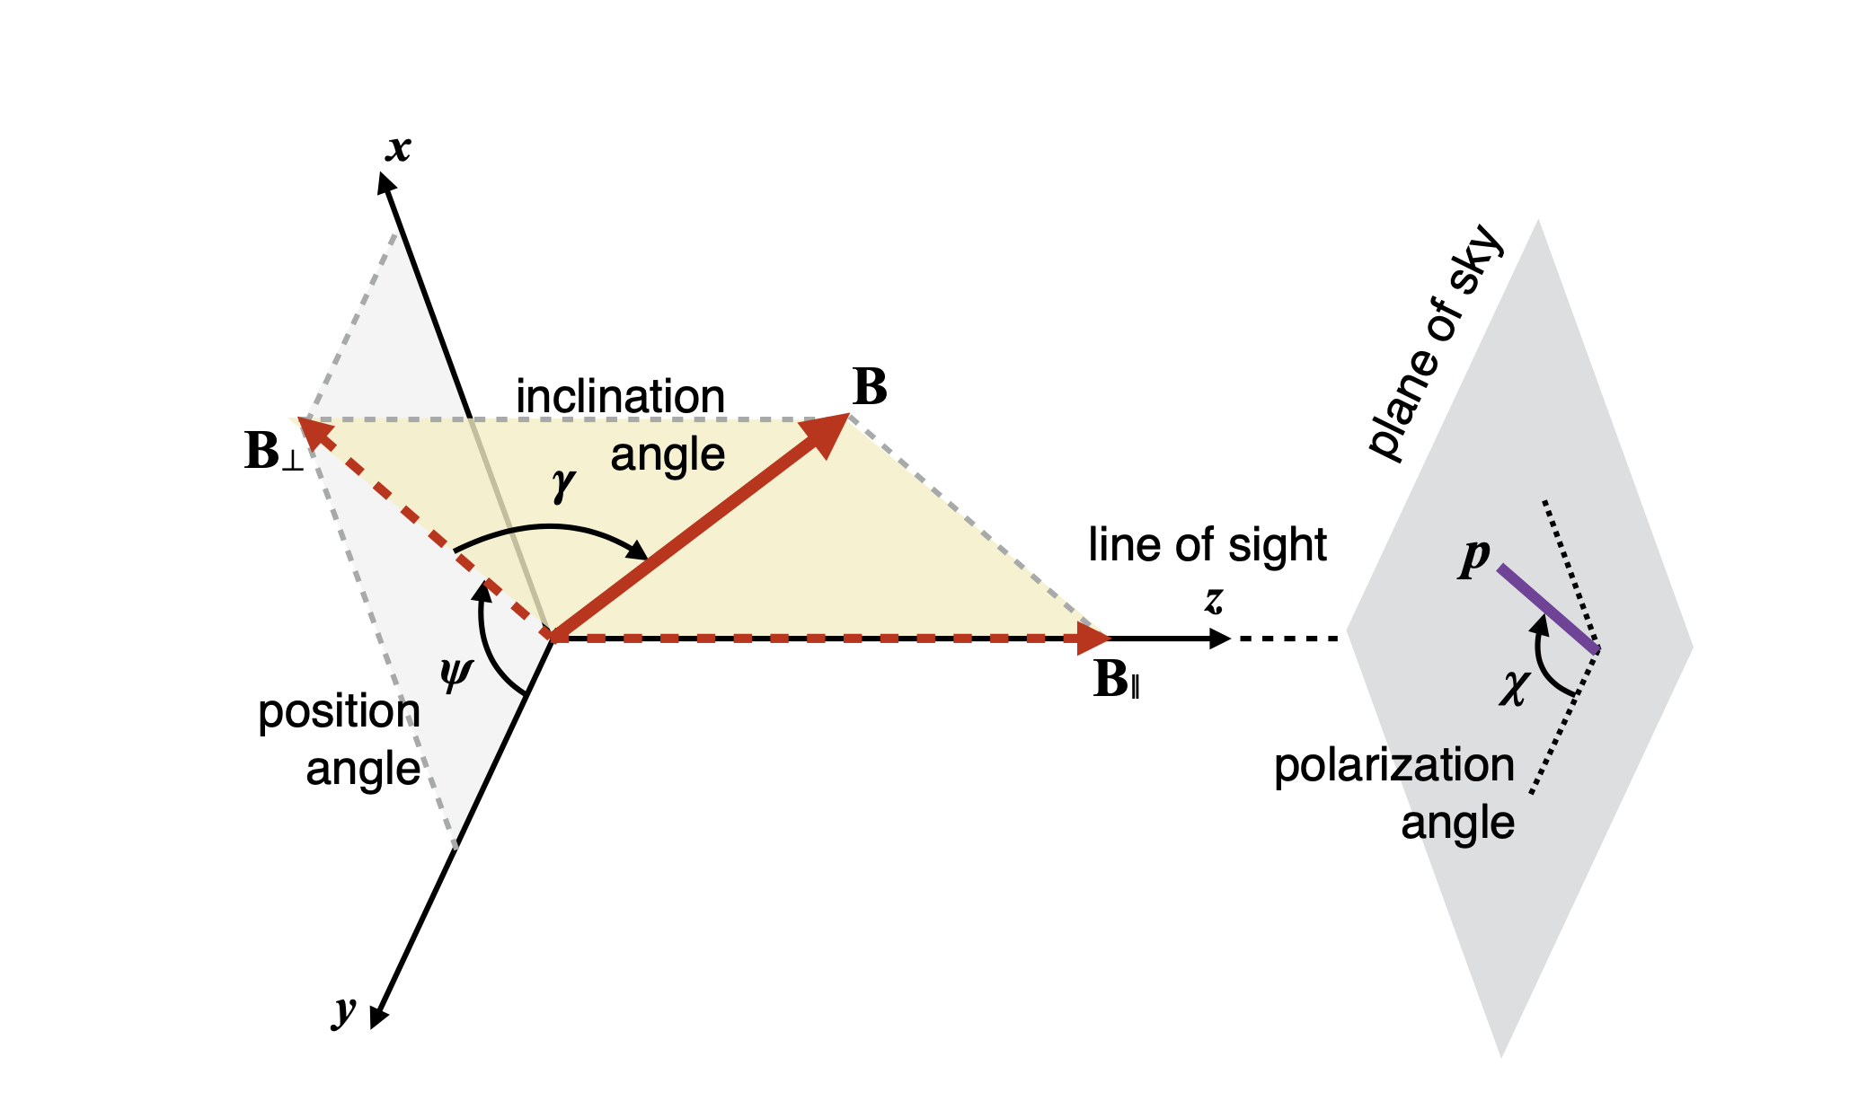
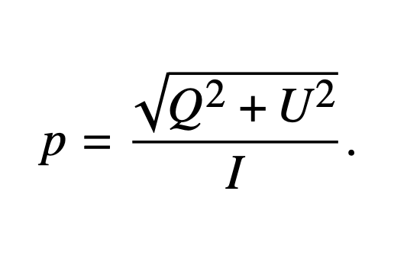
Dust Polarization
Particles align with magnetic field
Emits linearly polarized light
Gives orientation of magnetic field wrt plane-of-sky
Stokes parameters I, Q, U – degree of polarization
Notes:
- Non-spherical (dipole moment) dust grains align with their long axis perpendicular field, results in the emission of linearly polarized light (perpendicular) from the cloud
- Using the polarization fraction, we can determine the inclination angle of the magnetic field of the cloud on the plane of sky
- p found using Stokes parameters – linearly polarized light
- S-dispersion is the degree of dispersion of the polarization angles in angles in the cloud
For higher polarization fraction, there is a lower dispersion in S
Mninimal and max polarization values

Slide 6
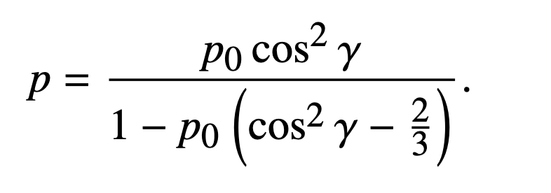
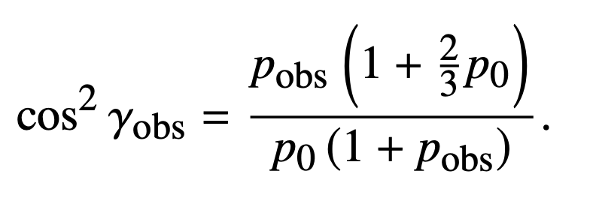
Inclination angle of the magnetic field
Polarization fraction, p, can be used to find inclination angle, γ
Notes:
(later)S-dispersion corrects for highly dispersed regions
Inverse relation between S and p
High inclination angle i.e. gamma = 0, max polarization, and inclination angle is completely on plane of sky
(γ is the highest possible γ value)
Get p for no variation along psi or gamma
P0, polarization coefficient, derived from max inclination angle
Assume p0 is same
Monte Carlo simulations

Slide 7
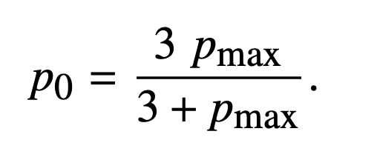
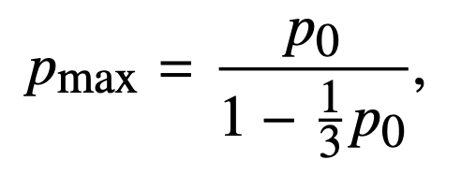

Slide 8
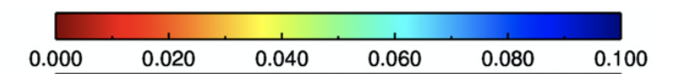
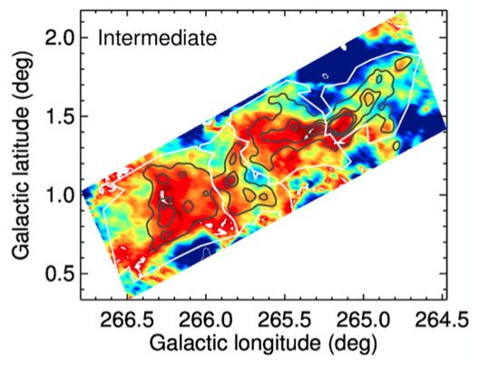
Vela C molecular cloud
Broken up into 5 different subregions (Hill et al.(2011))
~10⁵ 𝑀⊙
Filamentary structure
Center-Ridge and South-Nest are the two most contrasting regions in terms of temperature, star formation and filamentary structure, polarization fraction
Notes:
- mass: each region has about the same amount of mass
- North, Center-Ridge, Center-Nest, South-Ridge, South-Nest
- Center-Ridge and South-Ridge have dominating filamentary structures
- South-Ridge and South-Nest have cooler temperatures, and the South-Nest region has a weaker filamentary structure
- South-Nest is dominated by cooler temperatures, whereas the Center-Ridge has warmer and denser regions, and is more efficient in forming high-mass stars
- Transition: Monte Carlo simulations
- Polarization fractions of different regions

Slide 9
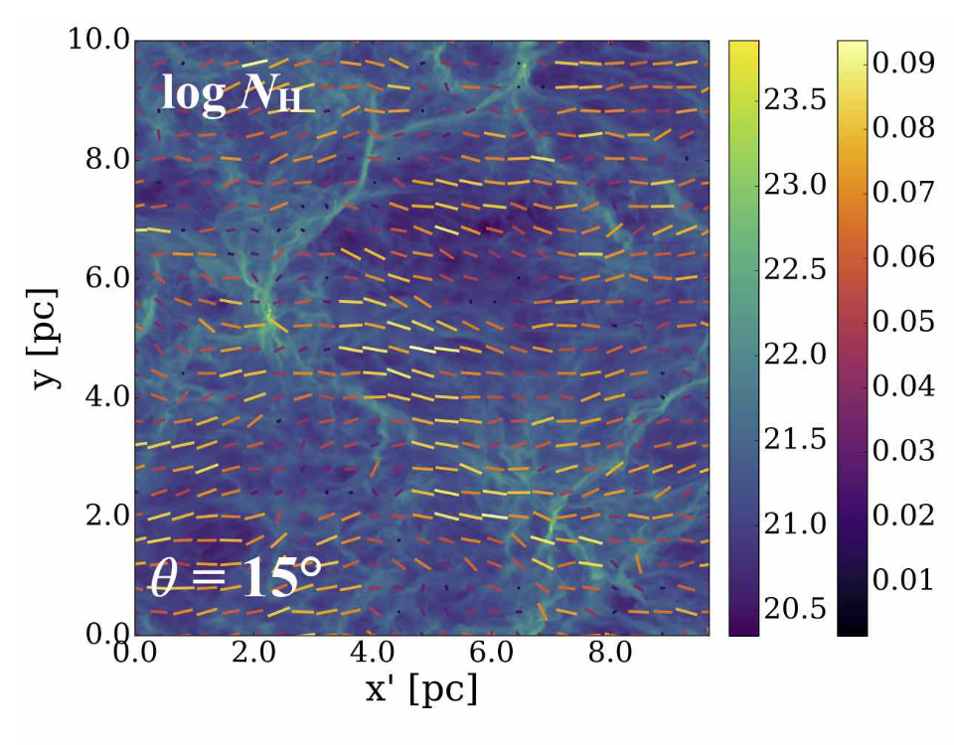
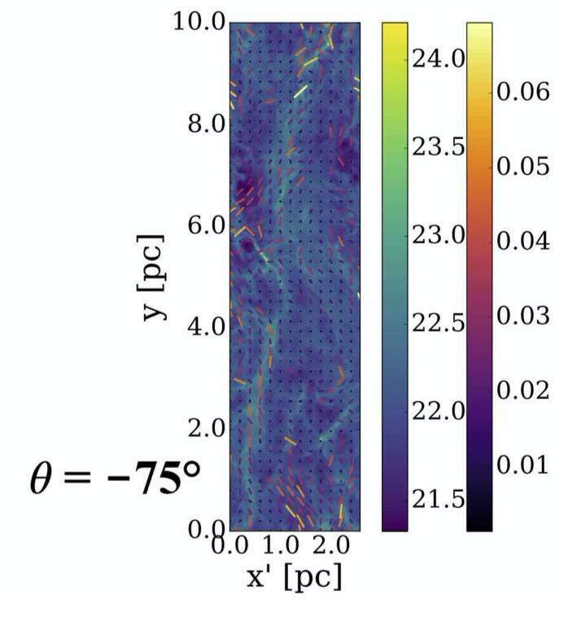
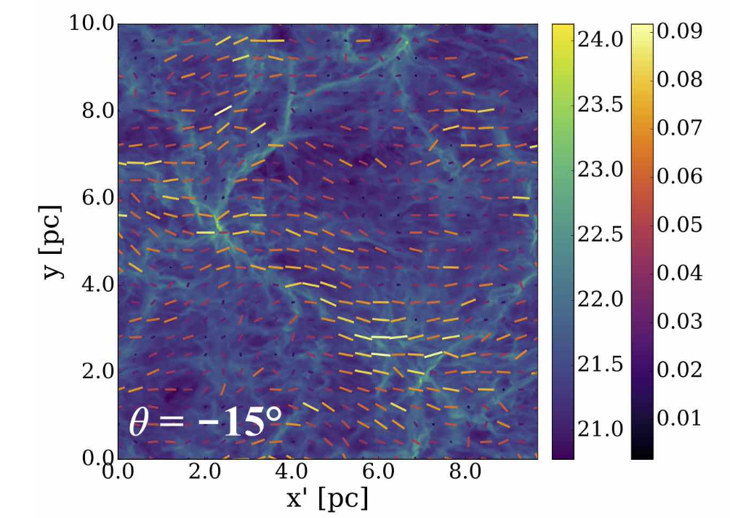
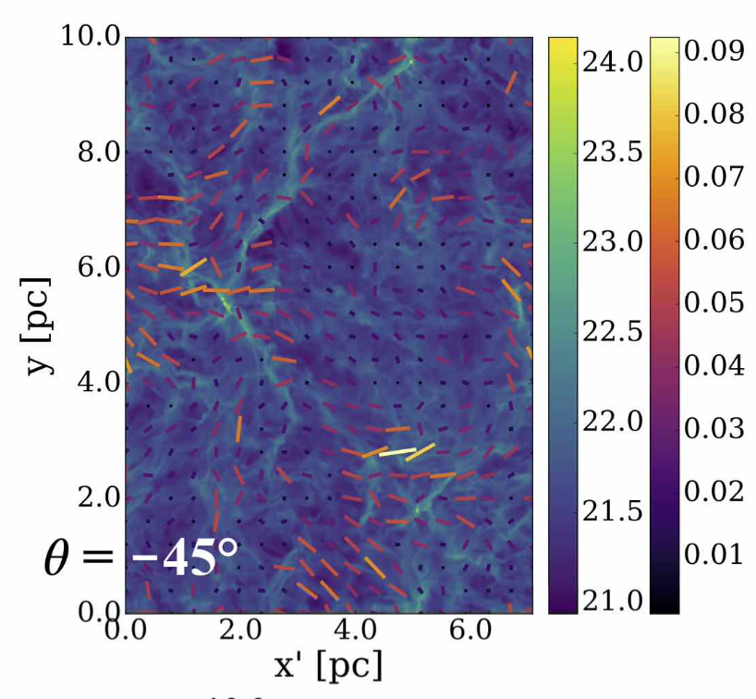
Notes:
Simulated Monte Carlo Simulations
Better 2D gamma values for S dispersion < Savg
Relation between column density and polarization

Slide 10
Inclination angle of the Vela C molecular cloud

Slide 11
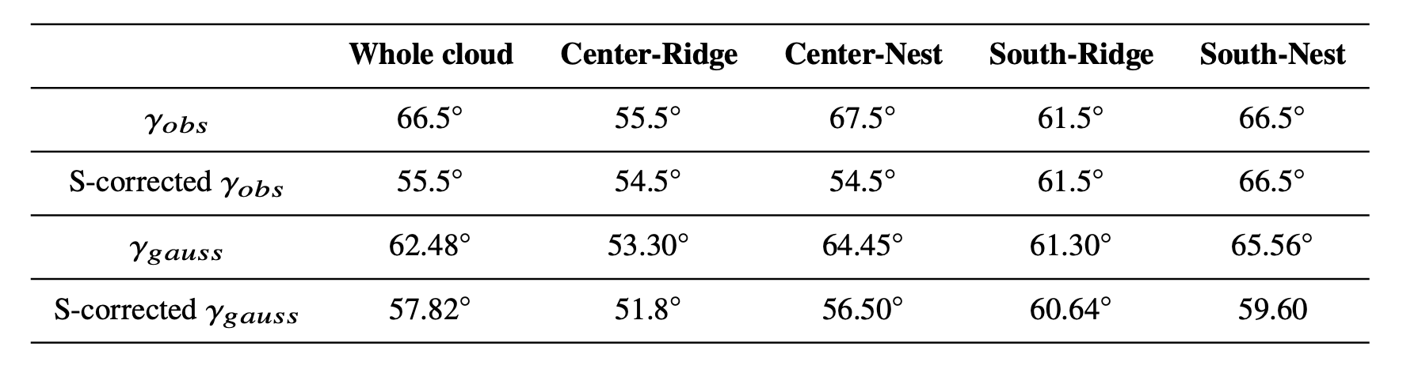
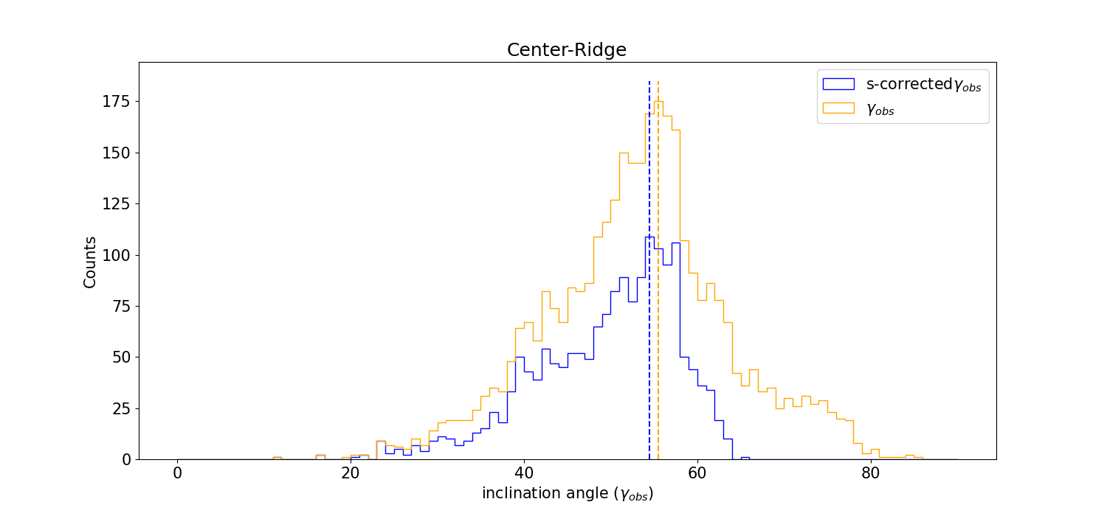
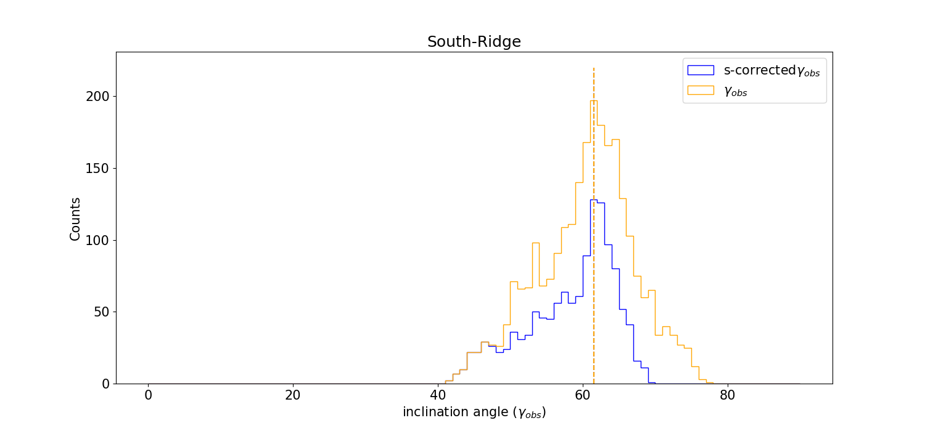
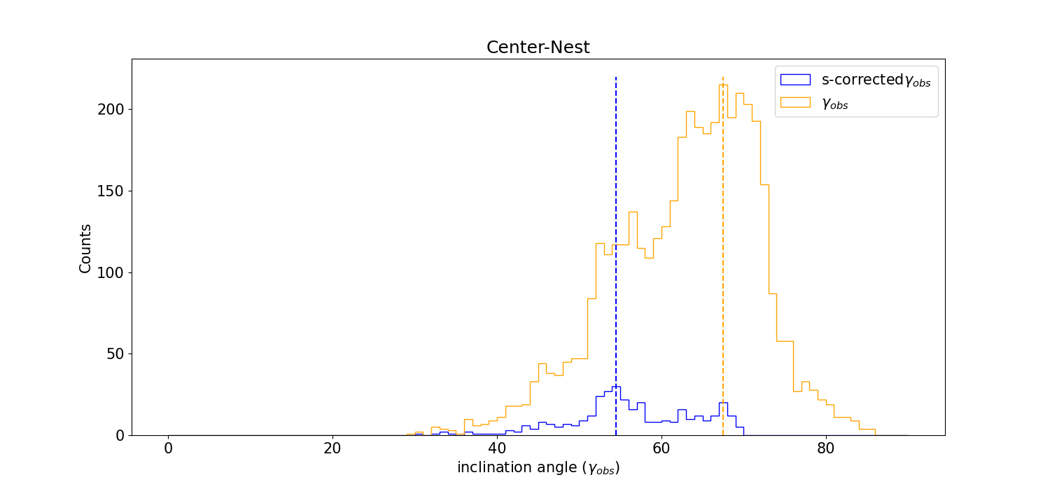
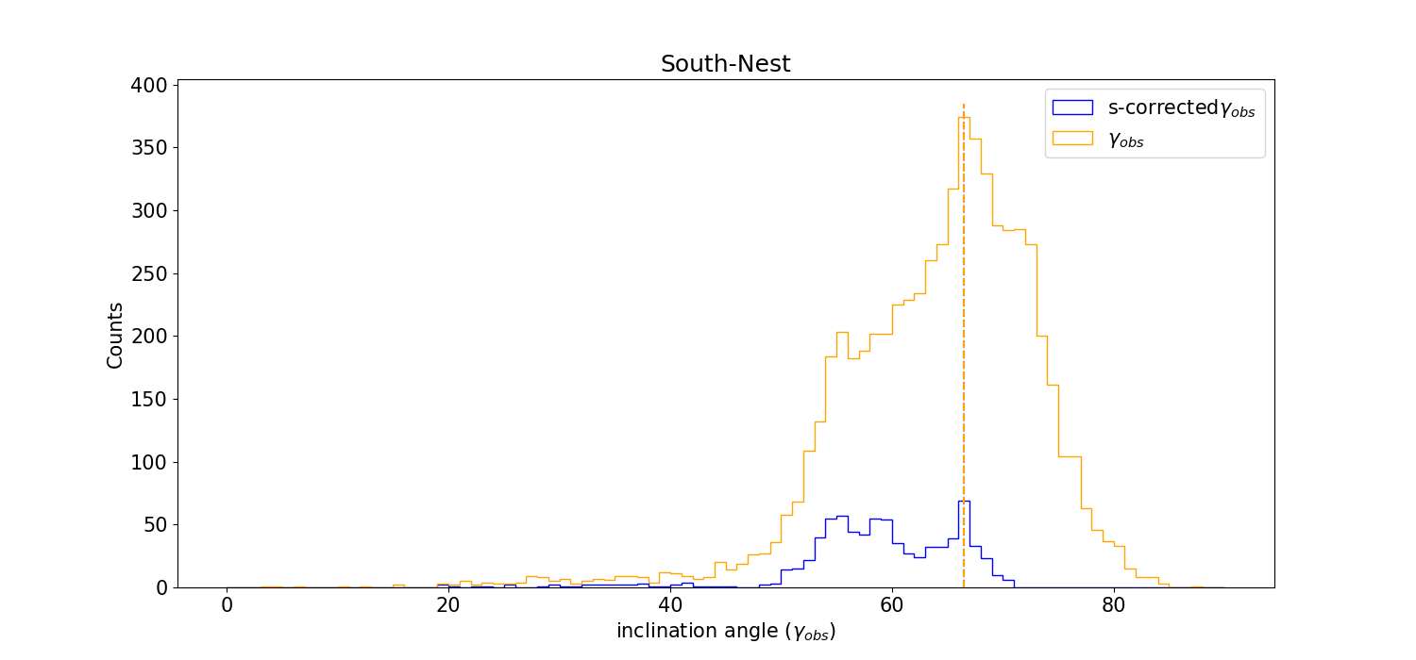
Inclination angle of Vela C
High inclination angle of ~60-65° (Chen et al. (2019))
Corrected for S-dispersion values
γ value from p is 64.9°
S corrected γ is 54.5°
Notes:
Inclination angles of each subregion of the molecular cloud
Inclination angle of the cloud found from polarization fraction
Vela C has a high inclination angle at ~60°-65°
S-dispersion gives lower inclination angles, which more closely align with simulations
Center-Nest and South-Nest are highest regions of dispersion
Center ridge – more parallel to pos
Center ridge – star formation
Weak mag field in south nest
Large LOS component and weak POS magnetic field component
- Lowest γ values given in the Center-Ridge, 54.5, compared to South-Nest, which has highest γ values of 66.5°
-Table of median of distributions
- Ander et al, more aligned dust grains
Gamma obs maps
Chen et. al gamma obs for S and p values
Bias corrected

Slide 12
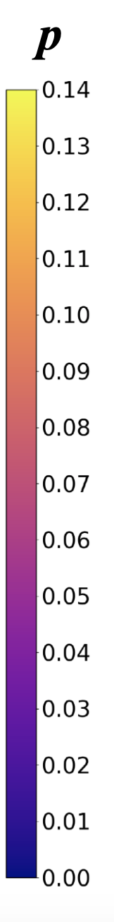
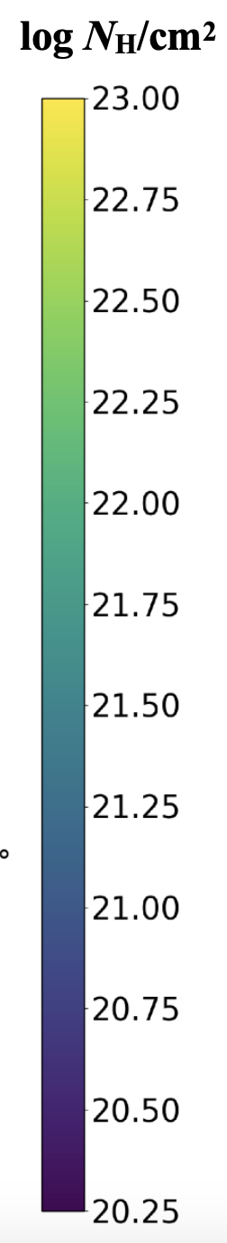
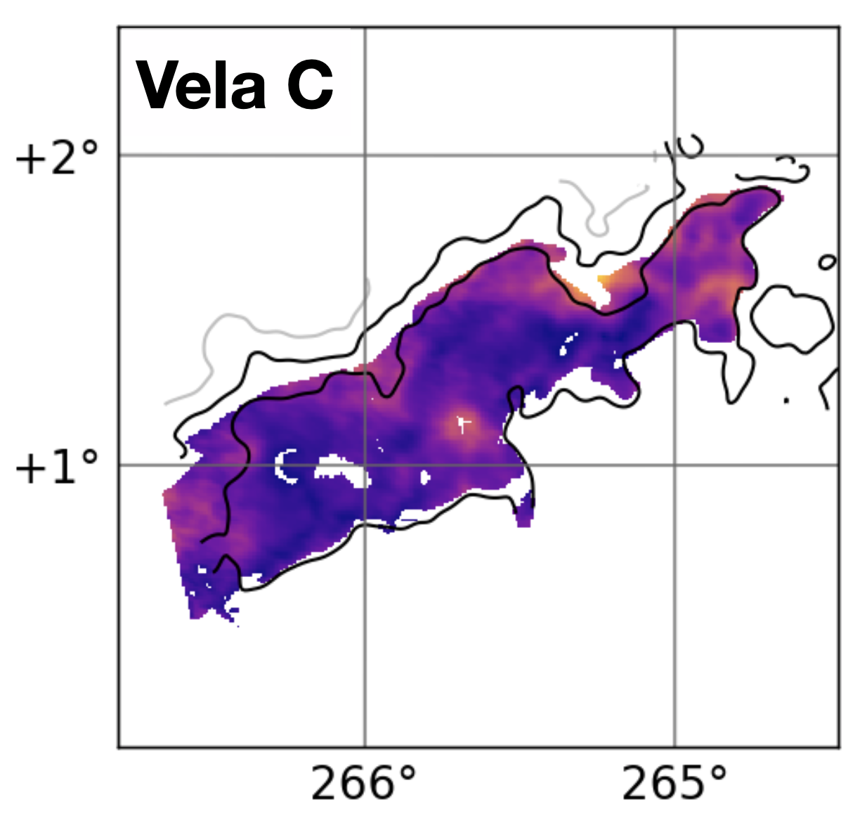
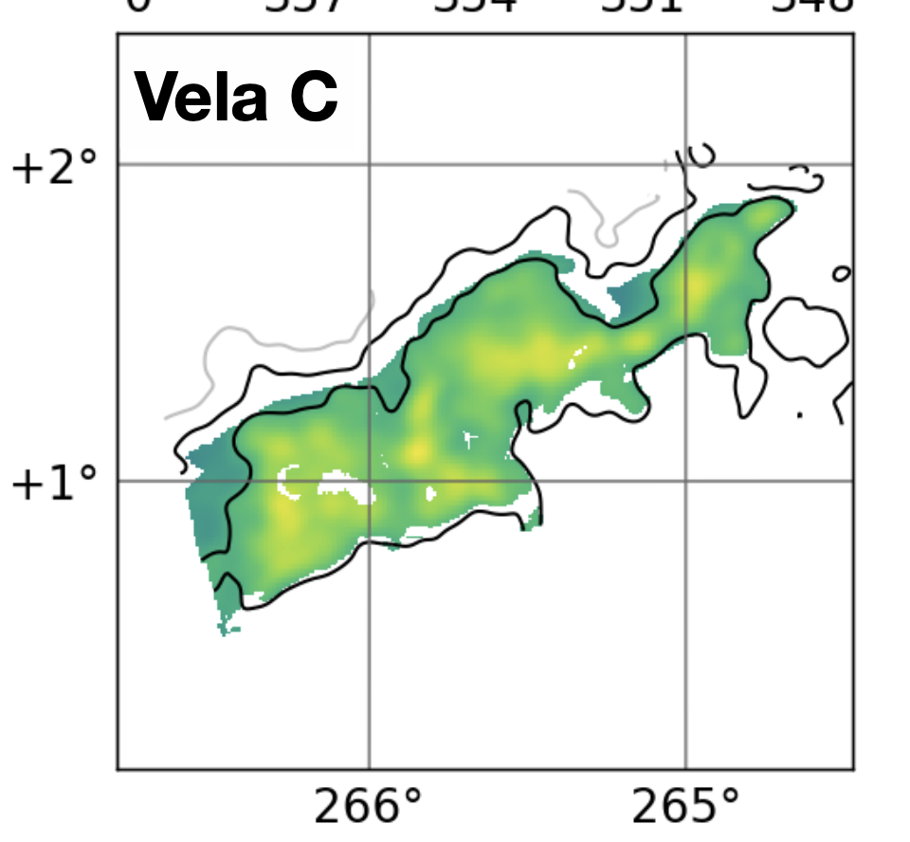
Notes:
Inverse relation between p and N_H
- The decrease of pwith increasing Sis expected because changes in the magnetic field direction within the cloud volume sampled by each measurement will lead to cancellation of polarization signals.

Slide 13
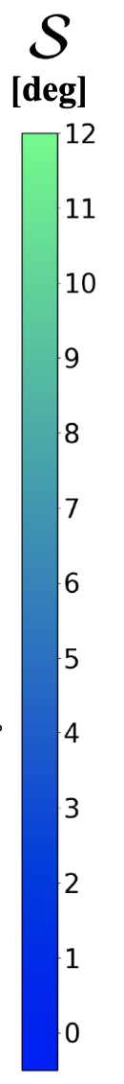
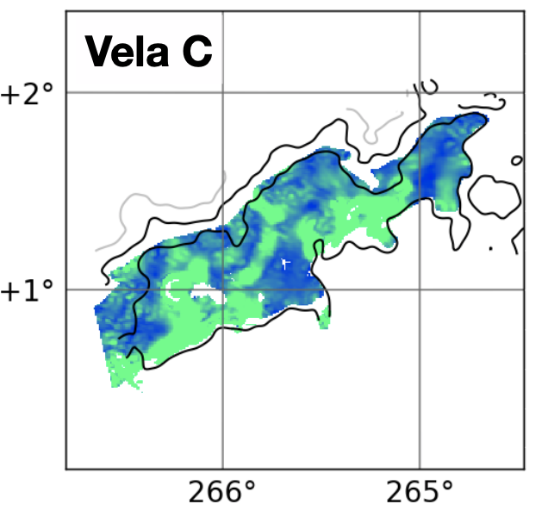

Slide 14
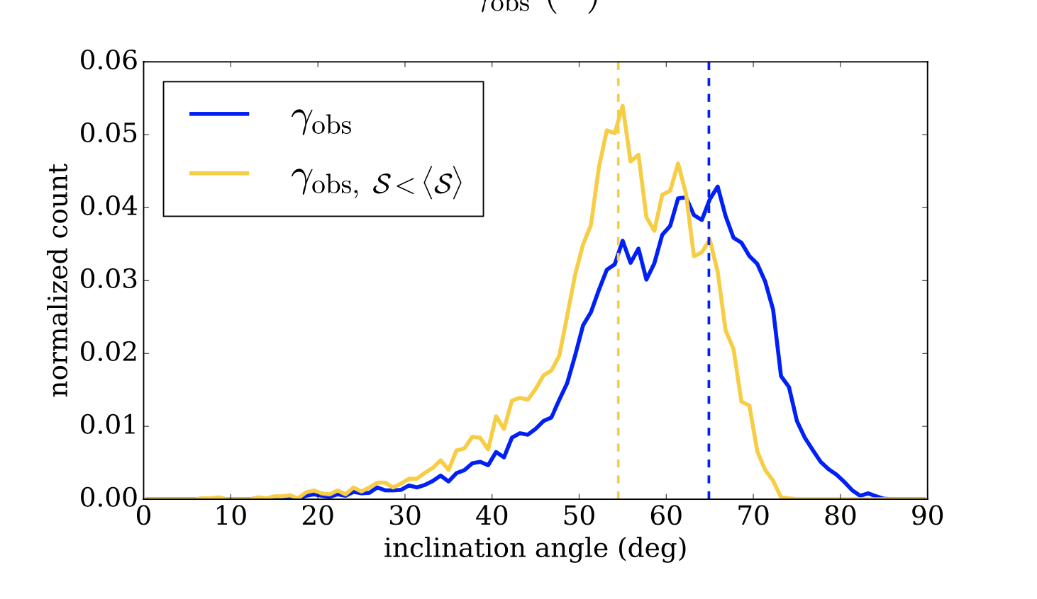

Slide 15
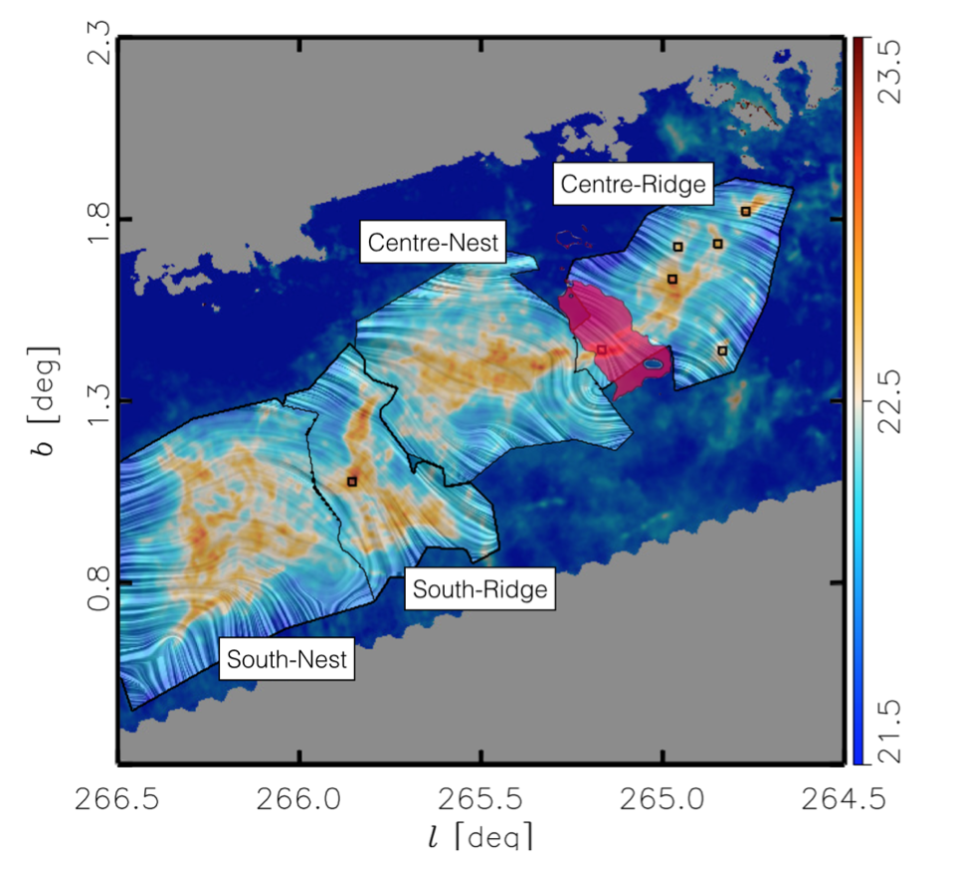
Conclusions
Lower S-dispersions have less dispersed bends in the field
Higher dispersions in the Center-Nest and South-Nest can be due to turbulence or high inclination angles (Center ridge – higher polarization compared to south nest)
Inverse relation between p and N_H
Further analysis of similar clouds can give more insight into the properties of the magnetic fields
Notes:
For lower γ values, more of the component of the magnetic field is in POS, and can in some regions can be seen to have less dispersed bends in the magnetic fields.
The Ridges have lower inclination angles and lower S dispersion compared to the Nests
In comparison to the results from the whole cloud, we see that different properties of each cloud can result in different inclination angles
Column density, temperatures and star formation abilities differ in different regions of Vela C
Inverse relation between p and N_H
By applying this to further molecular clouds, more robust conclusions can be drawn from how the polarization fraction, S-dispersion and inclination angles can be affected by the column densities of the subregions

Slide 16
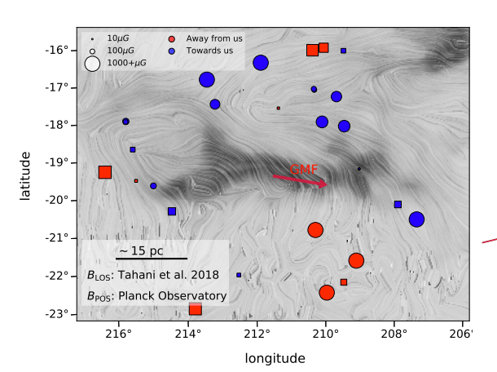
Next steps
Applications to other clouds
M. Tahini – Analysis of the Orion Cloud using Faraday rotation
Notes:
Tahini paper – higher polarization fraction values → orion

Slide 17
Works cited
Ade P. A. R., et al., 2015, Astronomy & Astrophysics, 576, A104 Aghanim N., et al., 2020, Astronomy & Astrophysics, 641, A12 Chen C.-Y., King P. K., Li Z.-Y., Fissel L. M., Mazzei R. R., 2019, Monthly
Notices of the Royal Astronomical Society, 485, 3499 Fissel L. M., et al., 2016, The Astrophysical Journal, 824, 134 Pattle K., Fissel L., Tahani M., Liu T., Ntormousi E., 2022, Magnetic fields in
star formation: from clouds to cores, doi:10.48550/ARXIV.2203.11179,
https://arxiv.org/abs/2203.11179
Soler J. D., et al., 2017, Astronomy & Astrophysics, 603, A6 Sullivan C. H., Fissel L. M., King P. K., Chen C.-Y., Li Z.-Y., Soler J. D.,
2021, Monthly Notices of the Royal Astronomical Society, 503, 5006 Tahani M., et al., 2022, Astronomy & Astrophysics, 660, A97

